Slide 1

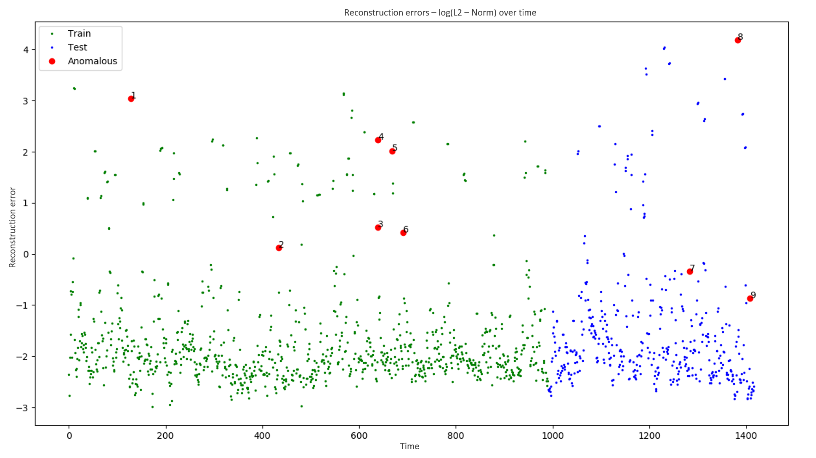
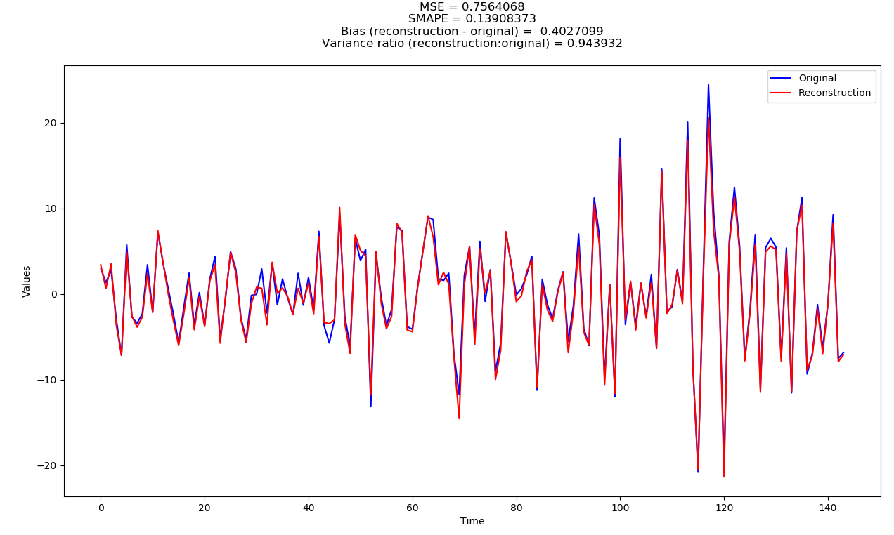
Anomaly detection and generation in time-series for predictive asset maintenance Final presentation 10th September 2019
Hitesh Kumar
Department of Earth Science and Engineering - Imperial College London
Data Science - Shell Research Limited

Slide 2
Overview
Background on the problem
Data and EDA
Anomaly detection
Anomaly generation
Question time

Slide 3
Background

Slide 4
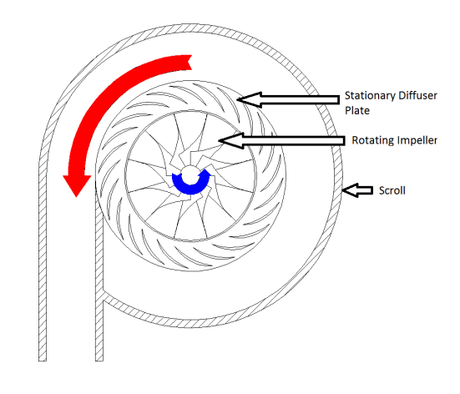
Some context first…
Compressors play a big part in natural gas extraction and processing.

Slide 5
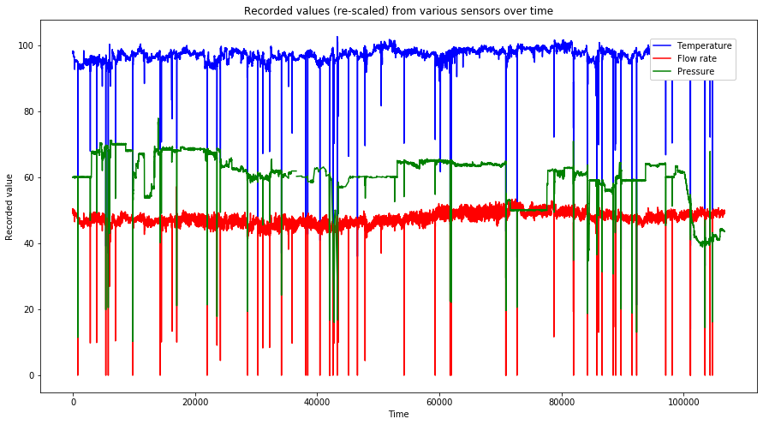
Some context first…
Input/output pressures, temperatures, flow rates and other variables change a lot during operation

Slide 6
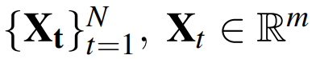
Some context first…
Input/output pressures, temperatures, flow rates and other variables change a lot during operation
So we have a m-dimensional multivariate time-series of length N

Slide 7
Some context first…
But sometimes they behave badly, causing:
Efficiency reduction
Automated/manual shutdowns
Damage to parts
Financial losses (for everyone) + Health and safety risks

Slide 8
Some context first…
So now we had our task; Multivariate time-series anomaly detection!
We split this into 3 sub-tasks
Find a way to detect anomalous intervals of time in our data-set
Predict the time until next anomalous event
Determine which features specifically are behaving anomalously/normally in said interval

Slide 9
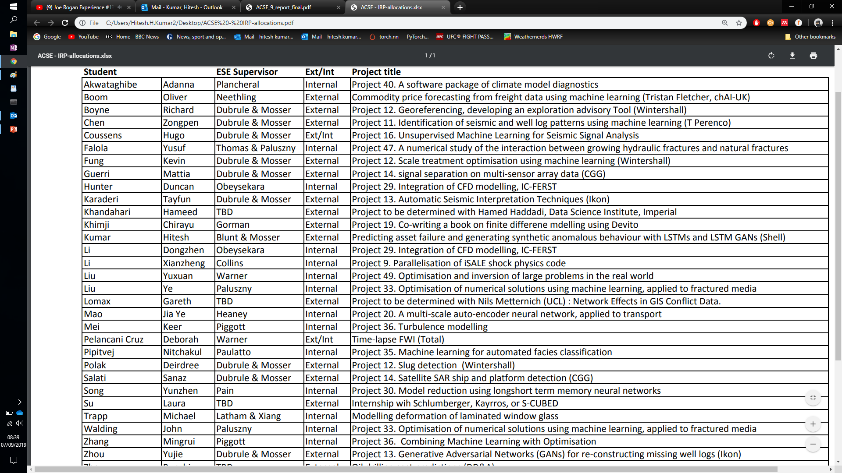
Data and EDA

Slide 10
Our data-set
N = ~130,000 at 10 minute intervals (~2.5 years of data!)
M = 405, but only 227 from the actual compressor

Slide 11
Our data-set
Lets look at time first:
Sometimes the compressor is offline

Slide 12
Our data-set

Slide 13
Our data-set
Lets look at time first:
Sometimes the compressor is offline
This is not “normal” behavior”
Get rid of it

Slide 14
Our data-set
N = ~130,000 ~106,000
M = 405, but only 227 from the actual compressor

Slide 15
Our data-set
Also, we observe the scale of the data changing really strangely at times…

Slide 16
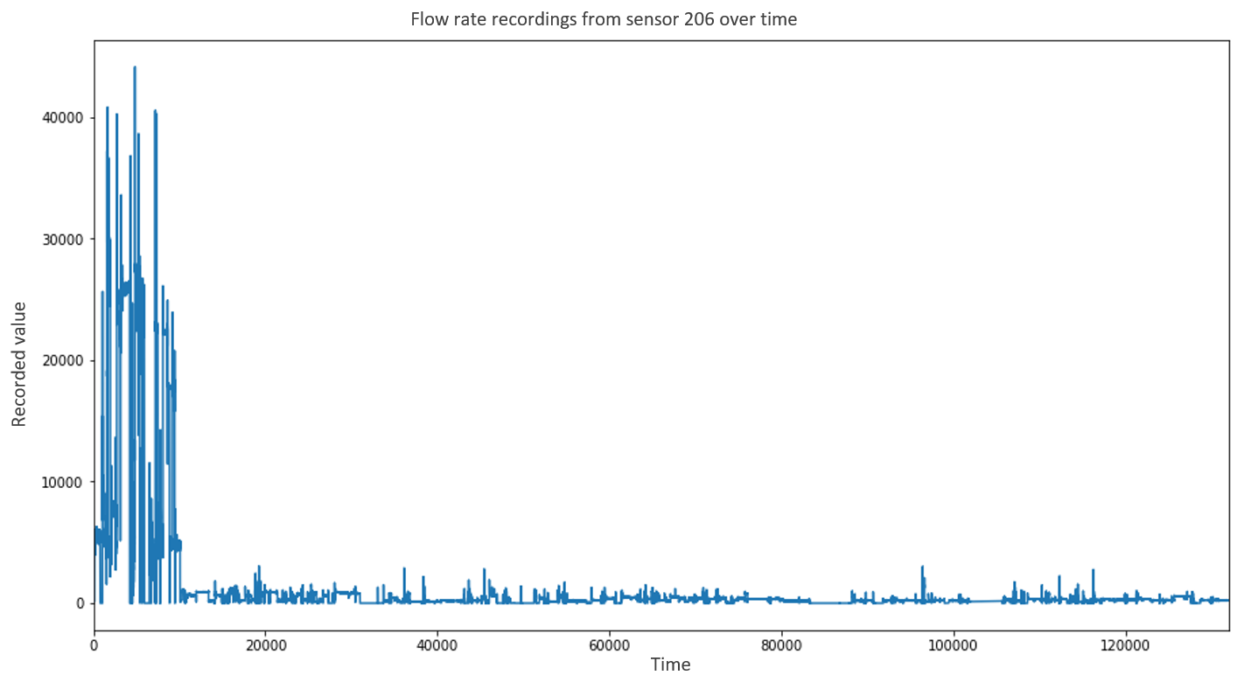
Our data-set

Slide 17
Our data-set
Lets look at time first:
Also, we observe the scale of the data changing really strangely at times…
We have no idea what units it was changed to and from
We tried rolling window normalization, squashing (sigmoid, tanh etc.) and other stuff

Slide 18
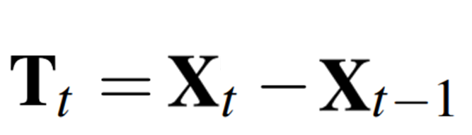
Our data-set
So we decided to instead take the differences between time-steps:

Slide 19
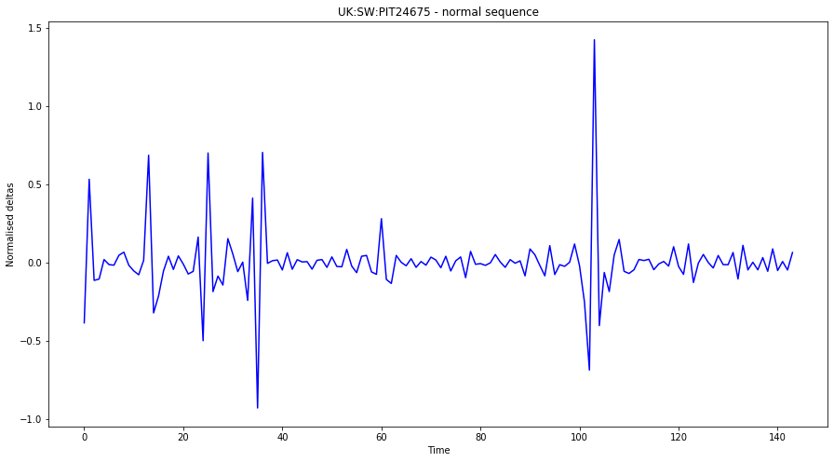
Our data-set
Now the data looks like this

Slide 20
Our data-set
And now in space:
There are some features which are just bad…

Slide 21
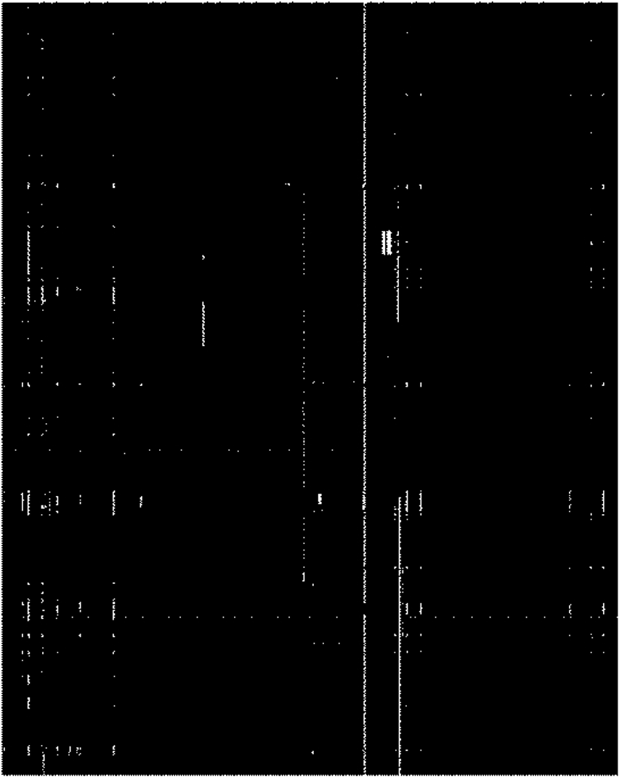
Our data-set

Slide 22
Our data-set
And now in space:
There are some features which are just bad…
So we came up with some criteria, get rid of any feature that:
Has too many missing values overall
Has too many consecutive missing values
Has too low a variance (under review)
Has Less than 2000 unique values
Has too many consecutive 0’s (no change) (second part only)

Slide 23
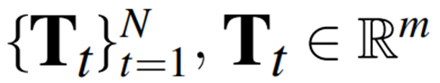
Our data-set
N = ~130,000 ~106,000 ~105,999
M = 227 112 (subject to decrease)
And finally we standardise this

Slide 24
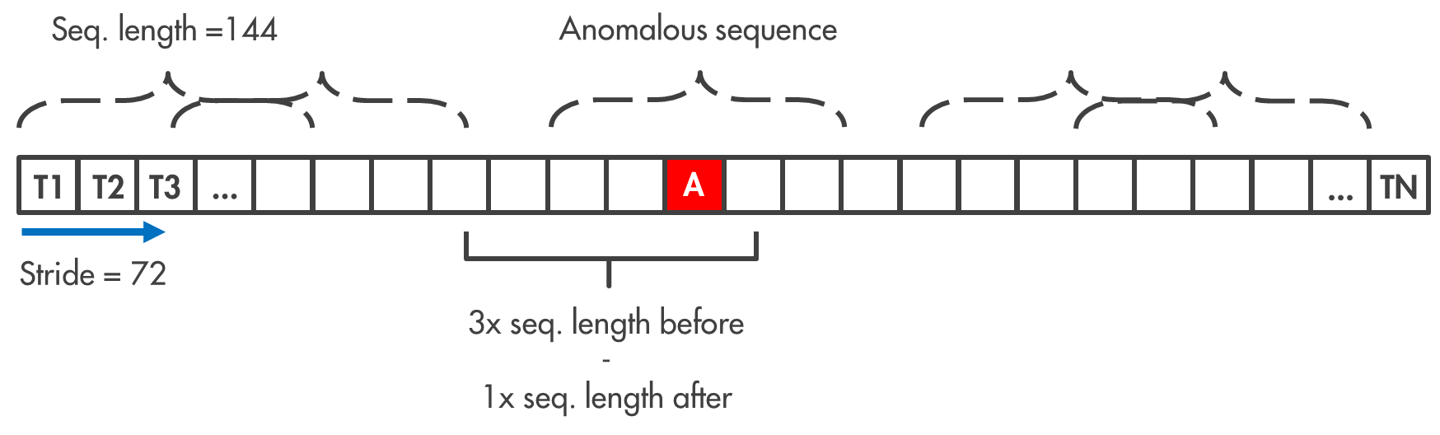
Our data-set
We need to create finite length sub-sequences out of this data

Slide 25
Our data-set
Now we have ~1400 sequences of 144 time-steps each
Each consecutive sequence is 50% the same (maximum) due to a 72-timestep stride
No overlap in training/validation/test sets
9 anomalies at 144 timesteps each, focal point at center in time
PyTorch DataLoader!

Slide 26
Anomaly detection

Slide 27
Considerations
But now we have two issues:
There isn’t any easy way to measure how anomalous time-series are

Slide 28
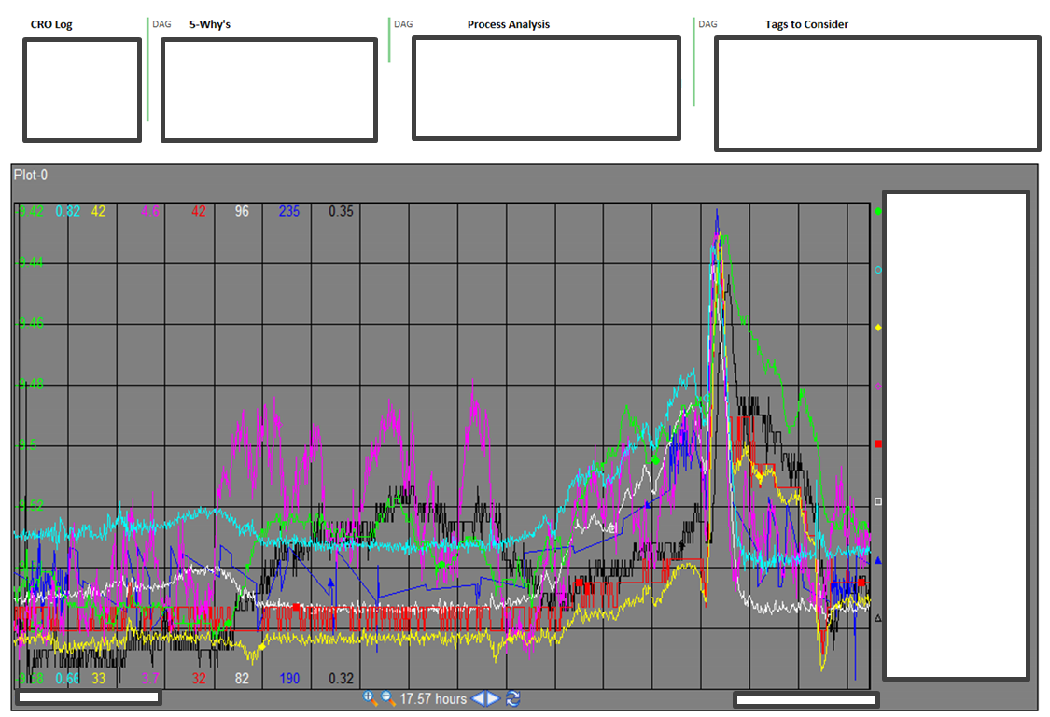
Considerations

Slide 29
Considerations
But now we have two issues:
There isn’t any easy way to measure how anomalous time-series are
There are very few labelled anomalies in the data set

Slide 30
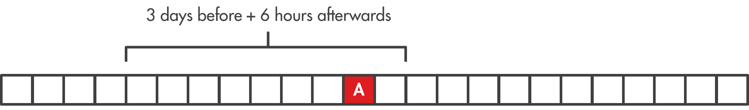
Considerations
We only have 9 labelled anomalies: 9 points in time out of 130,000!
Even by expanding the windows to multiple days around each anomaly, we can only get 4428 points in total.
3%!

Slide 31
Considerations
But now we have two issues solutions:
There isn’t any easy way to measure how anomalous time-series are – Deep Learning
There are very few labelled anomalies in the data set – Unsupervised
LSTM Auto-encoder

Slide 32
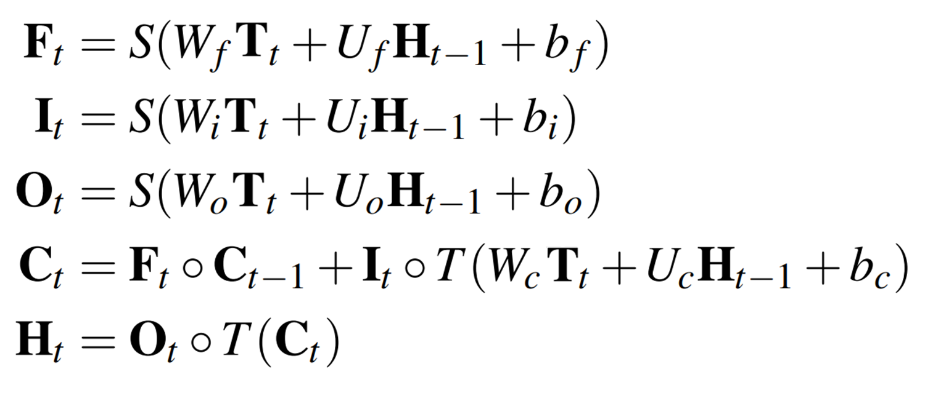
Model and results
LSTM:

Slide 33
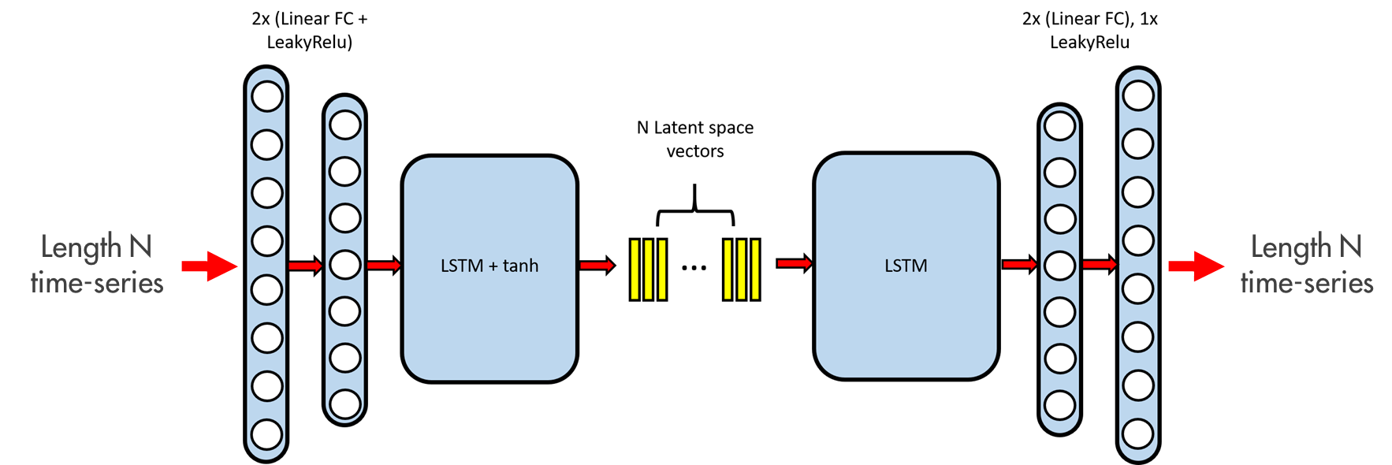
Model and results

Slide 34
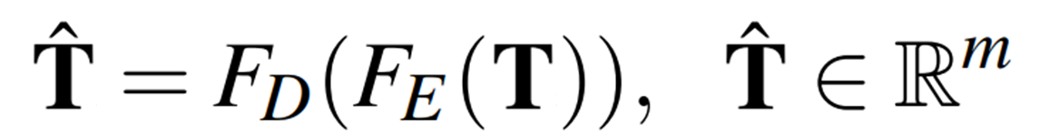
Model and results
Mathematically:
Latent vectors

Slide 35
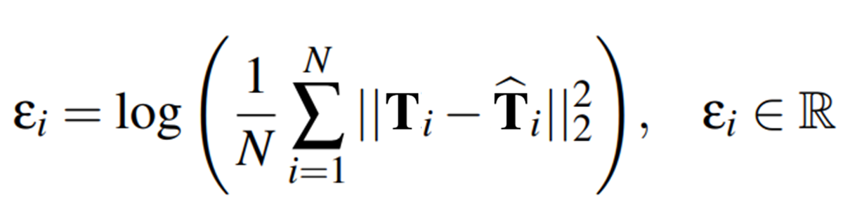
Model and results
Reconstruction error:

Slide 36
Model and results
So there are two things everyone expects from Auto-encoders:
Encoded latent vector projections – Encoding + PCA/TSNE

Slide 37
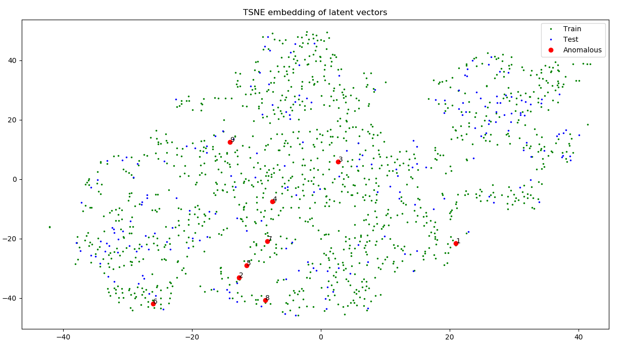
Model and results

Slide 38
Model and results
So there are two things everyone expects from Auto-encoders:
Encoded latent vector projections – Not so good
Reconstruction errors

Slide 39
Model and results

Slide 40
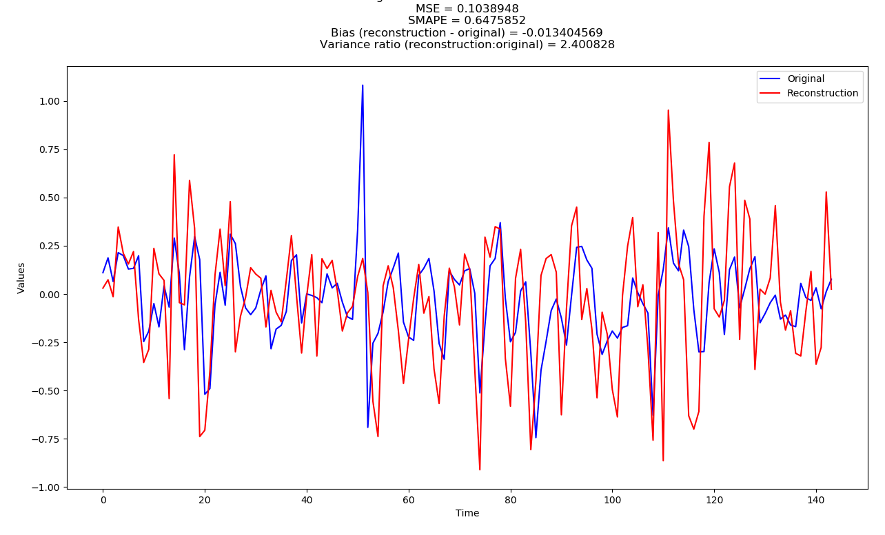
Model and results

Slide 41
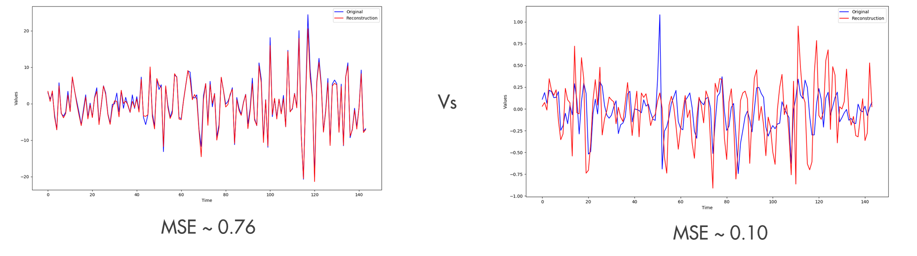
Model and results
Recon errors (loss function) could be 400x larger
No incentive to optimise for most features
Result is based on a few features only

Slide 42
Model and results

Slide 43
Model and results
So there are two things everyone expects from Auto-encoders:
Encoded latent vector projections – Not so good
Reconstruction errors – Pretty good

Slide 44
Model and results
Now we just need to classify these reconstruction errors somehow
Look at reconstruction error distribution
Decide a threshold to balance FPs/FNs

Slide 45
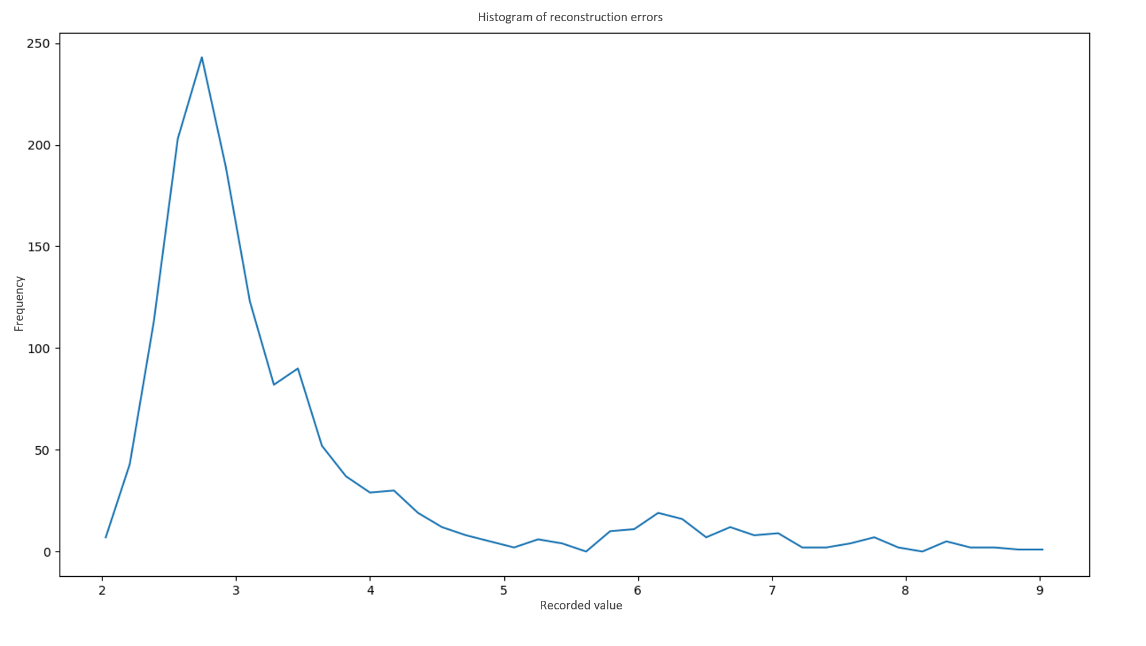
Model and results

Slide 46
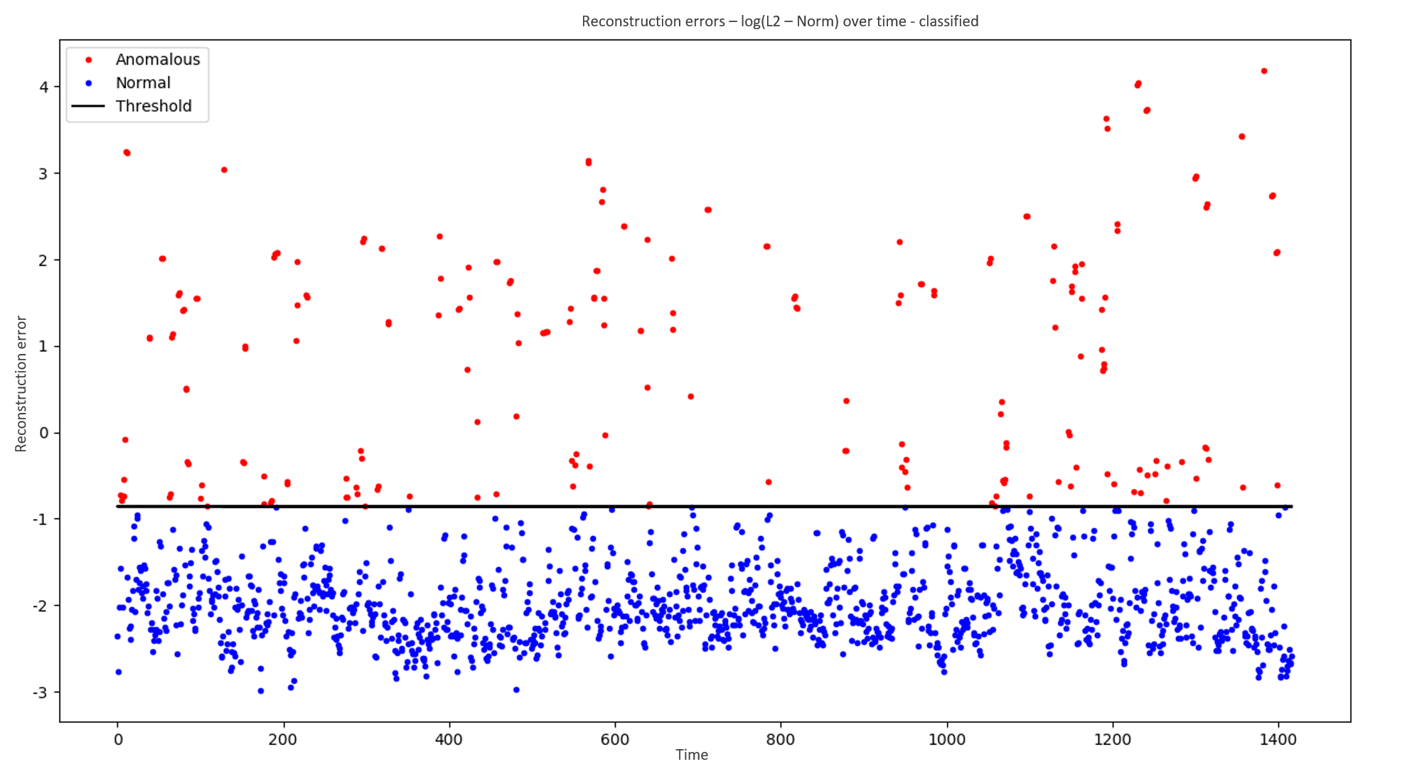
Model and results

Slide 47
Model and results

Slide 48
Model and results

Slide 49
Model and results
Predicted Actual | True | False | Total
True | 1203 | 205 | 1408
False | 1 | 8 | 9
Total | 1204 | 213 | 1417

Slide 50
Further work
Better data-preprocessing
More experiments with latent space and projections
Sample variance weighted loss function – More inclusive reconstructions

Slide 51
Further work
Better data-preprocessing
More experiments with latent space and projections
Sample variance weighted loss function – More inclusive reconstructions
Time-dependent classification boundary

Slide 52
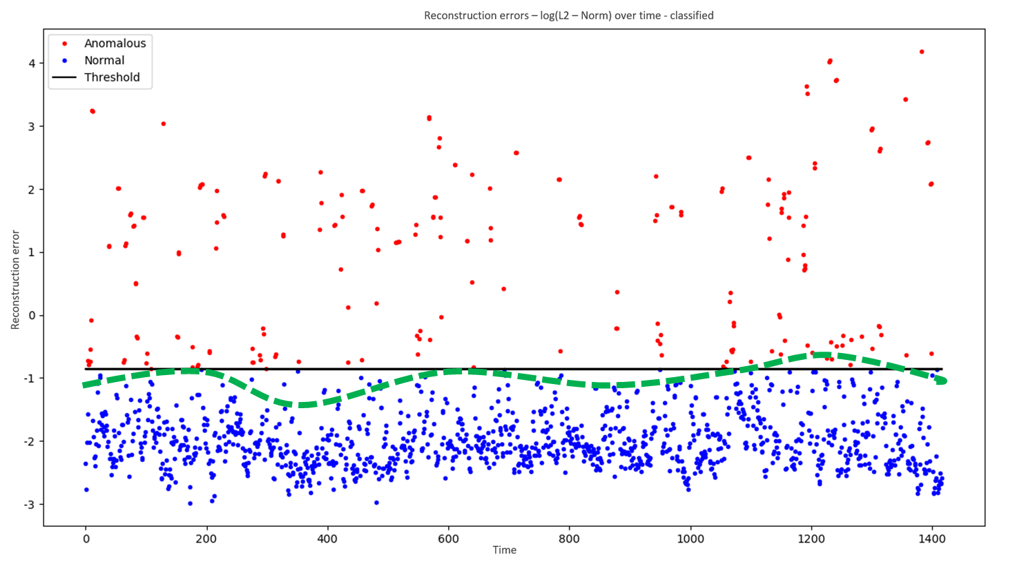
Further work

Slide 53
Further work
Better data-preprocessing
More experiments with latent space and projections
Feature variance weighted loss function – More inclusive reconstructions
Time-dependent classification boundary
Time-to-failure predictions based on reconstruction error time-series

Slide 54
Anomaly generation

Slide 55
Why do we need to generate data?
Why do we even need more data?

Slide 56
Why do we need to generate data?
Perhaps we can get some success with supervised methods?
Reduce class imbalance
Train RNN-based direct classification models
Perhaps even direct time-to-failure models?...

Slide 57
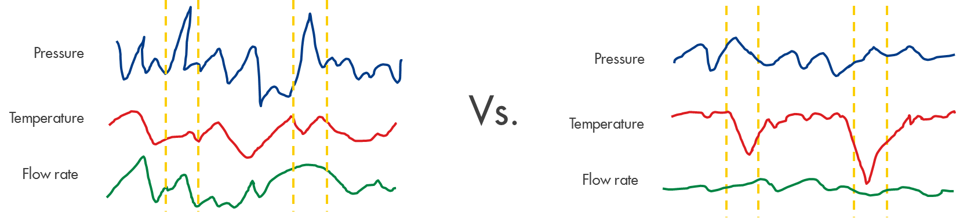
Why do we need to generate data?
...and would like to learn more about various types of anomalies…

Slide 58
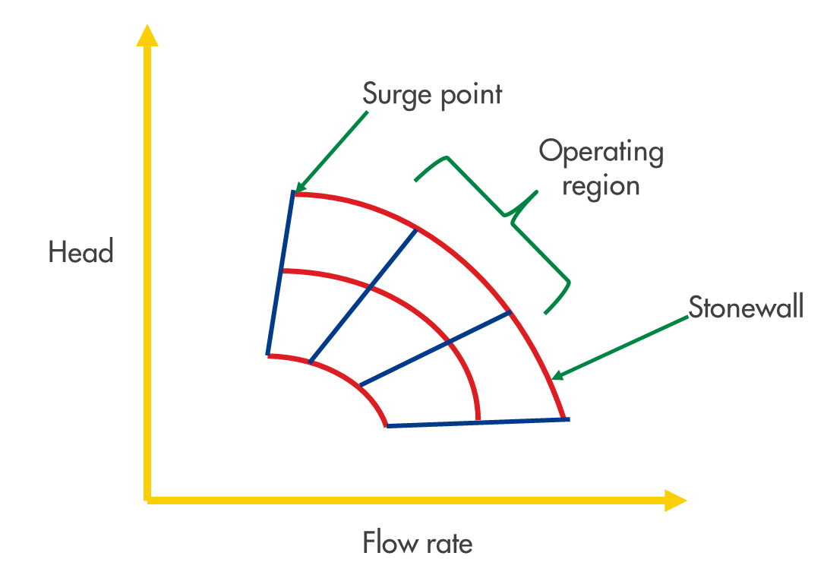

Why do we need to generate data?
…as well as new anomalies that are very rare or impossible.

Slide 59
Considerations
We have a 3 step plan:
We have to be able to sample from the real data distribution
We need to post process a string of random samples into a realistic time-series
We need to figure out how to make “anomalous-looking” time-series
?
?
?

Slide 60
Considerations
Step 1: Lets see the distribution first

Slide 61
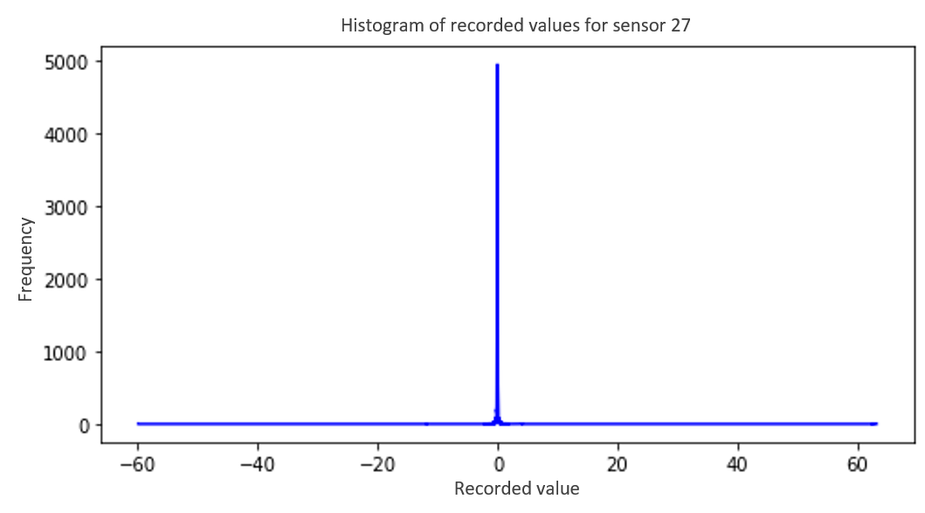
Considerations
98% of all data
1%
1%

Slide 62
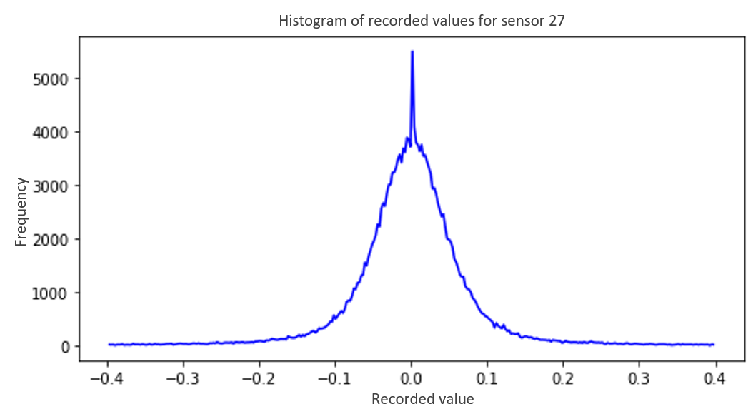
Considerations

Slide 63
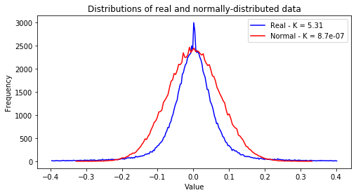
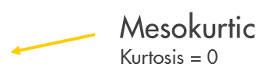
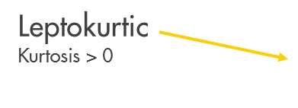
Considerations

Slide 64
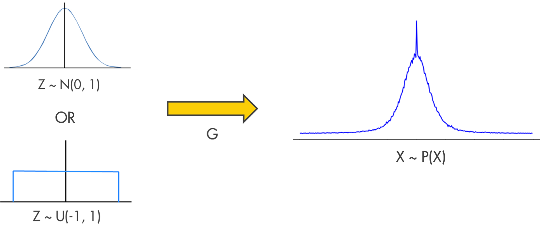
Considerations
- Essentially we want to create some mapping from samples from one distribution to another:

Slide 65
Model and results
We tried some simple ideas…
Approximate the inverse CDF of the data
Kernel density estimation with bootstrapping
Maximum likelehood/Bayesian methods
But these require certain conditions/assumptions, and hard to scale

Slide 66
Model and results
…But in the end we chose to go with
Generative adversarial networks (GANs)

Slide 67
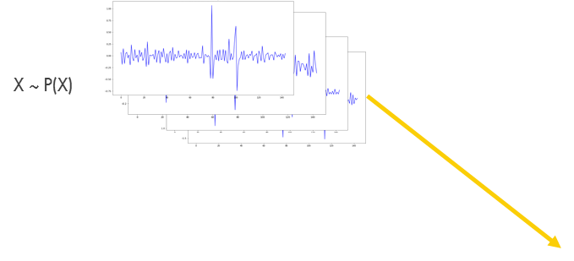



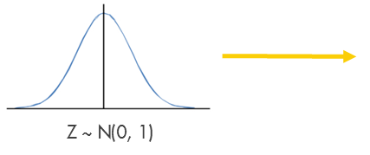
Model and results

Slide 68
Model and results
Some that we implemented:
GAN
LSGAN
WGAN
WGAN + GP

Slide 69
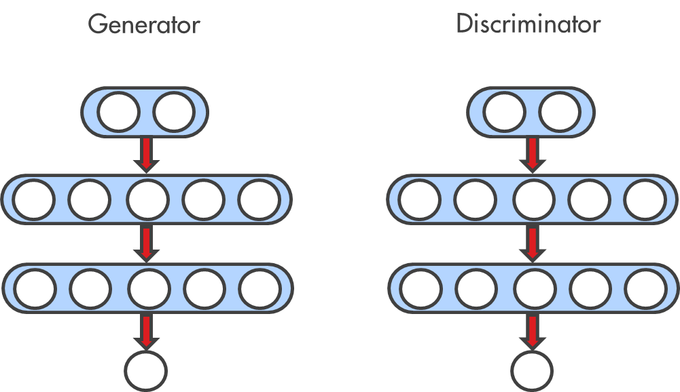
Model and results
The architecture (MLP):

Slide 70
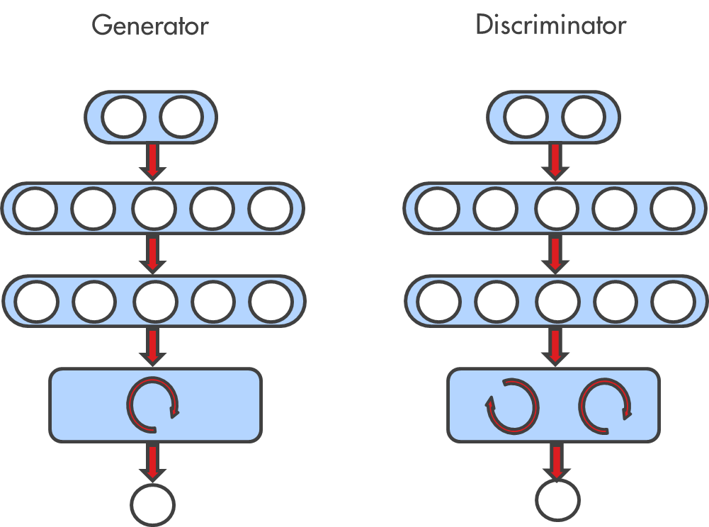
Model and results
We tested a few architectures:
- MLP
RNN

Slide 71
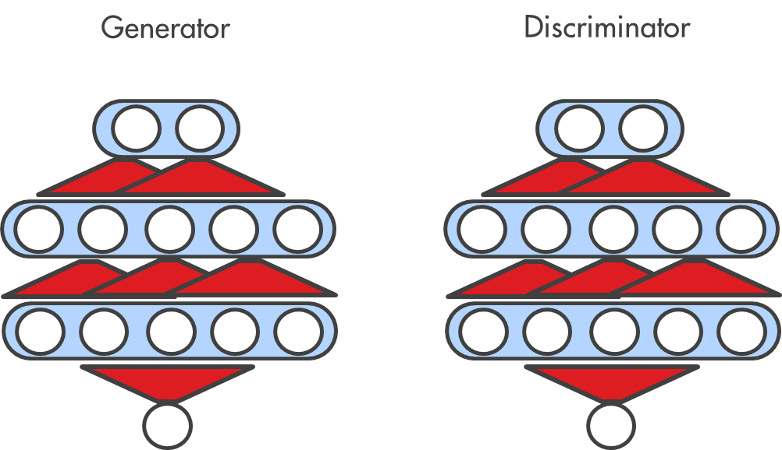
Model and results
We tested a few architectures:
- MLP
RNN
Temporal convolutions

Slide 72
Model and results
Some just didn’t work no matter what was tried:
- MLP - Some success
RNN - Some success
Temporal convolutions – No success

Slide 73
Model and results
Details:
Multi-layer perceptron (4 linear layers) with LeakyReLU non-linearity
Learning independent, One-dimensional distribution of each feature separately
Latent space larger than output space (Generator)
Discriminator has around 100x capacity of generator
No Recurrent layers – Optimisation and loss has nothing to do with temporal dependencies
Keep step 1 as pure as possible – learn the distribution only

Slide 74
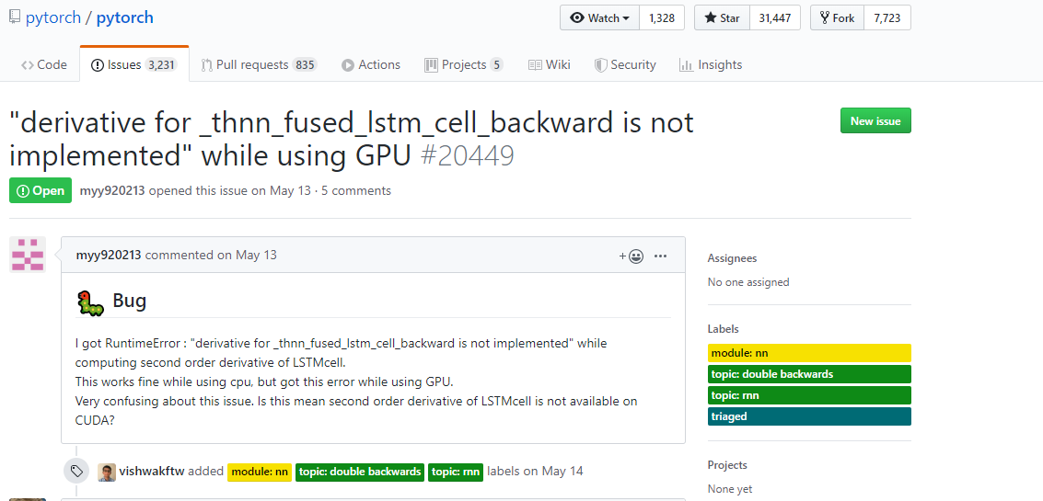
Model and results

Slide 75
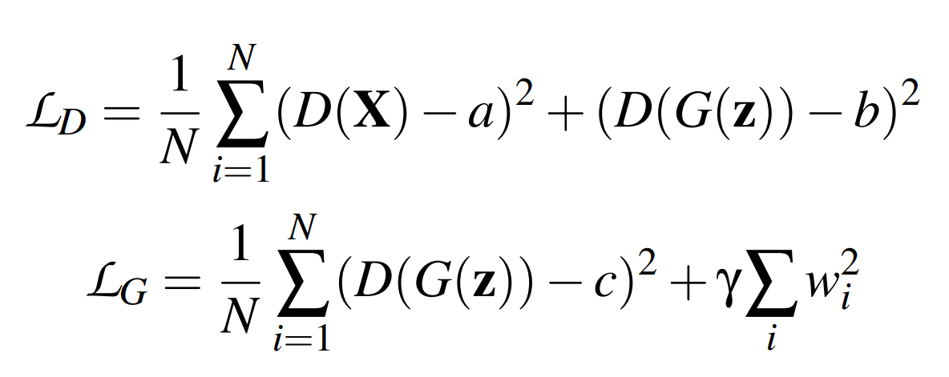

Model and results
After a lot of experiments, went with LSGAN + generator weight decay

Slide 76
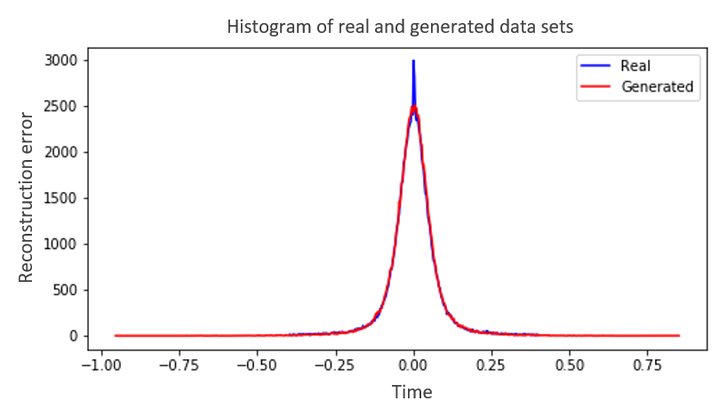
Model and results
And got good results!

Slide 77
Model and results
A = C = 1
B = 0
Gamma = 0.01

Slide 78
Model and results
Applied weight decay to generator:
Much more stable and smooth convergence

Slide 79
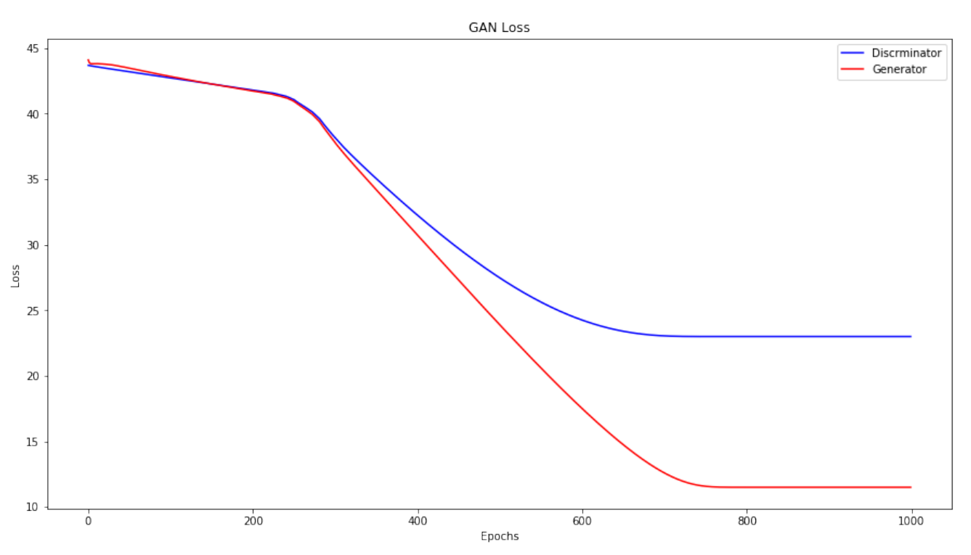
Model and results

Slide 80
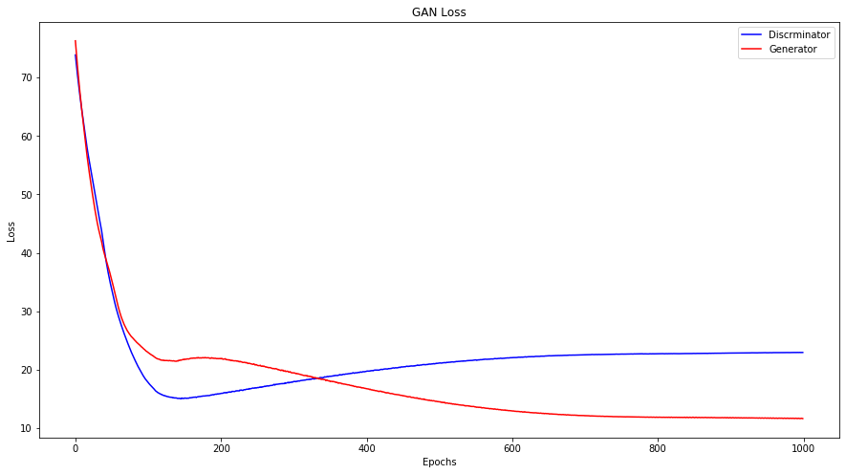
Model and results

Slide 81
Model and results
Applied weight decay to generator:
Much more stable and smooth convergence
Very reliable convergence

Slide 82
Model and results
Models Results | GAN | LSGAN | WGAN | WGAN + GP
JS-divergence | 0.089 | 0.0034 | 0.014 | 0.013
W-distance | 197.01 | 15.40 | 80.92 | 46.57

Slide 83
Further work
So far we’ve only accomplished step 1…
We have to be able to sample from the real data distribution
- Extend to multivariate distributions
We need to post process a string of random samples into a realistic time-series
We need to figure out how to make “anomalous-looking” time-series
But time was nearly up, so we had to git going

Slide 84
Further work
But we have some plans:
PLAN 1:
Merge steps 1 and 2:
Dual/Multi discriminator GANs
Multi-objective recurrent GANs
What is a “real” time-series?

Slide 85
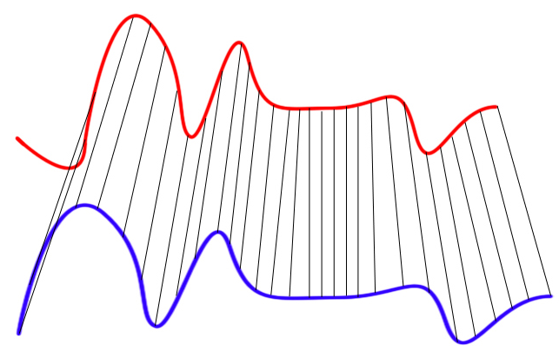
Further work
Dynamic time warping (DTW)
Similarity measure between time series
No strong assumptions about the data (scale invariant)
SoftDTW – differentiable implementation

Slide 86
Further work
But we have some plans:
PLAN 1:
Merge steps 1 and 2:
Dual/Multi discriminator GANs
Multi-objective recurrent GANs
Step 3:
Randomly adding short-term large scale noise?
LSTM post-processor
What is a “real” time-series?

Slide 87
Further work
But we have some plans:
PLAN 2:
Step 1 remains same
Merge steps 2 and 3:
De-noising auto-encoders
Style transfer models

Slide 88
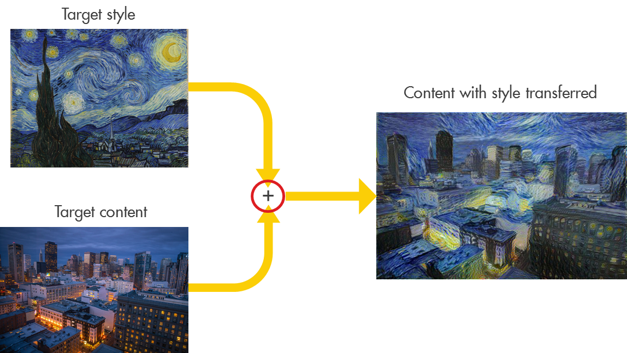
Further work
Style transfer models

Slide 89
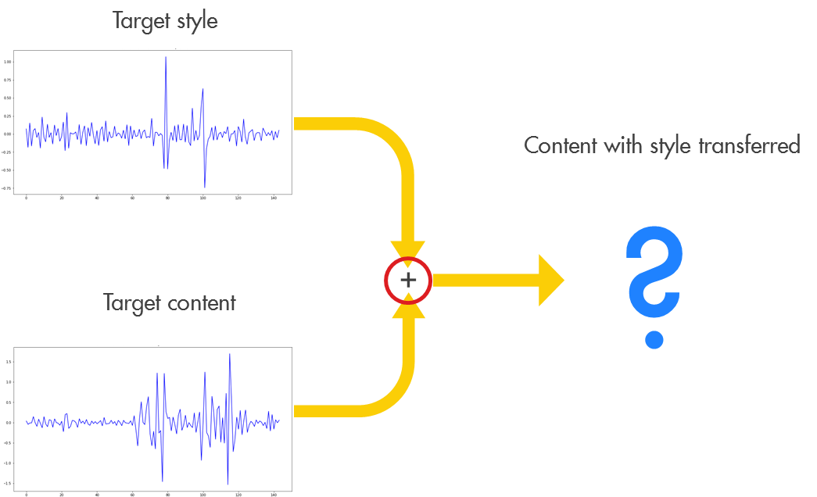
Further work
Style transfer models

Slide 90
Summary
Compressors are crazy
Real data is very messy – still not done cleaning
Anomaly detection shows some good first results – can be much improved
Anomaly generation has just started, and needs a lot more research
So much more can be done…

